Slide 1
Top 10 missing features (and ways to add them)
Axel Faust / Oksana Kurysheva

Slide 2
Top 10 missing features (and ways to add them)
Axel Faust / Oksana Kurysheva

Slide 3
Top 10 missing features (and ways to add them)
Axel Faust / Oksana Kurysheva

Slide 4
10 missing features
Existing add-ons that should be part of core
Features easy to implement during a project
Nonexistent feature, that should be implemented

Slide 5
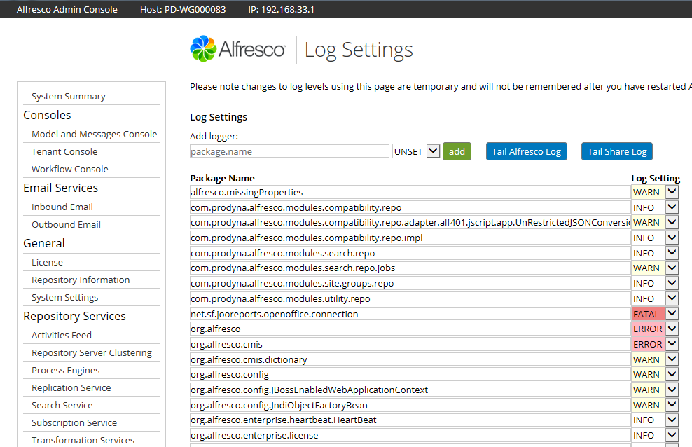
Support Tools (for Community)
LGPL addon by A. Soler
Enterprise-only
Heavy use of JMX
Most useful
Log4j settings
Scheduled jobs
Transformation test
Thread dump / hot threads

Slide 6
Support Tools (for Community)
(New) Repo admin console since 5.0d
In Enterprise since 4.2
(Almost) all features not JMX-dependant
JMX „convenient“
Most backing beans either in CE or JVM
Needed: volunteers for „migration“ / refactoring

Slide 7
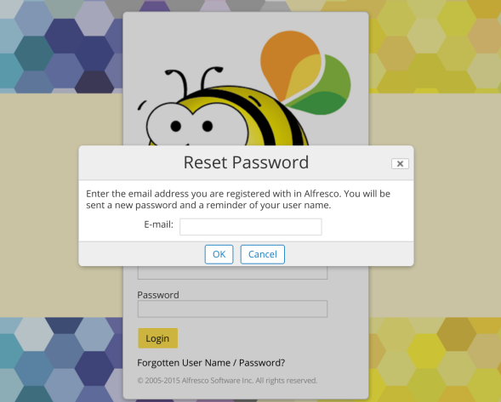
Reset password
Users often forget their passwords. What should they do in this situation?
https://github.com/share-extras/reset-password-dialog

Slide 8
Track content usage on any node
Standard “quota” of limited use
Only live content
Only limit – no “info-only”
Out-of-the-box / addons
Global user quota
Folder / sites quota
https://github.com/keensoft/alfresco-myfiles-quota
Index-based “best estimate”

Slide 9
Track content usage on any node
Better tracking is possible
Policies as triggers
UsageService (>= Alf 3.0) for data
“Better” data is possible
Aggregate including versions
Differentiate “primary” / “secondary” paths

Slide 10
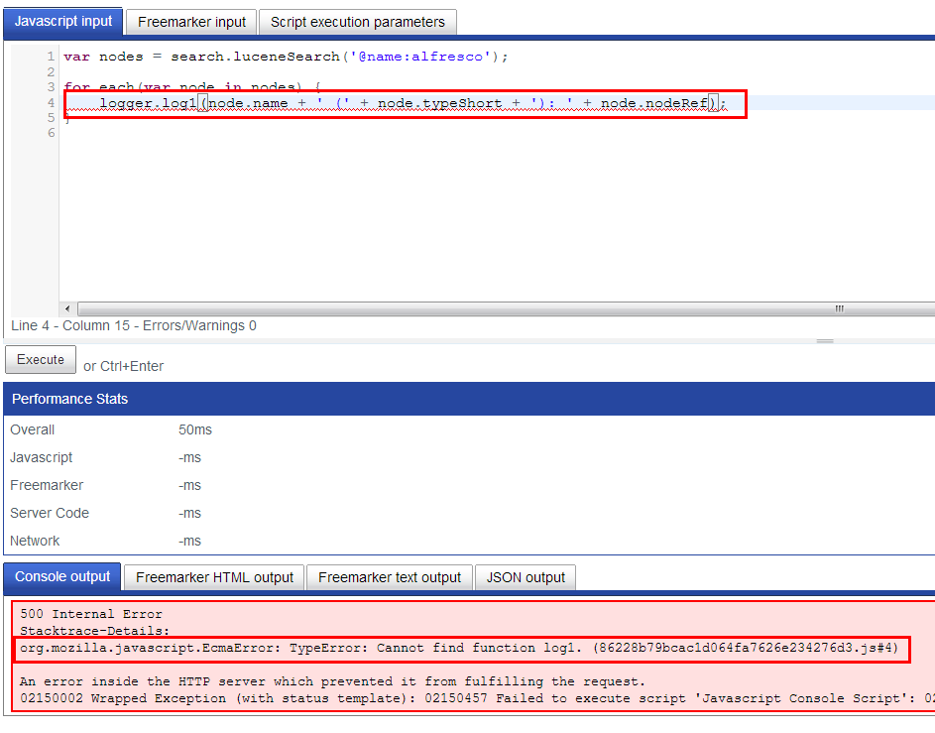
JS Console
Executing scripts in Alfresco repository from Alfresco Share – indispensable tool to develop and test repo-side APIs, rules and workflow listeners
https://github.com/share-extras/js-console

Slide 11
Property Inheritance
No support of any metadata inheritance in standard Alfresco
Node A
Properties
Association
(to master
data node)
Common: copy on
association (policy)
Node B
Properties
Issues:
Redundancy / bloat of database tables
Consistency (one-off copy vs. performance impact of sync on change)

Slide 12
Property Inheritance
Alternative to „copy“
Mix on access
DAO / AOP-based
DB
NodeDAO
Inheritance Rule
Determine inherited
properties
Register Evaluate
RuleManager
Proxy
Lookup rules for node
NodeService

Slide 13
Property Inheritance
Mix on access
Always up-to-date
No redundancy
Cache for performance
Drawbacks
Not DB-queryable (full index support)
What‘s inherited? What‘s really set?
DB
NodeDAO
Inheritance Rule
Determine inherited
properties
Register Evaluate
RuleManager
Proxy
Lookup rules for node
NodeService

Slide 14
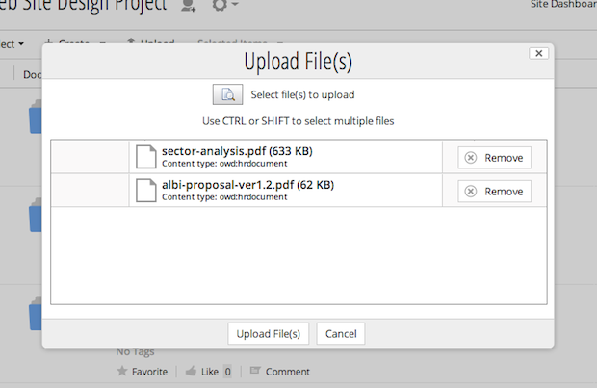
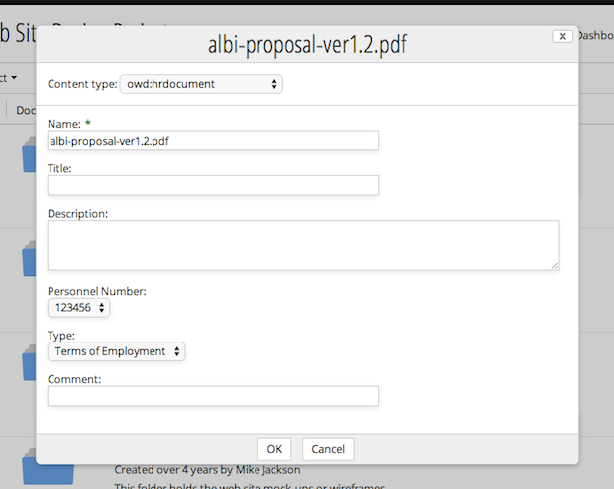
Requesting the metadata during uploading the content
It's strange to say that fields are mandatory in the content model, if users can upload a file and don't touch metadata, so all fields will be empty.
https://github.com/softwareloop/uploader-plus

Slide 15
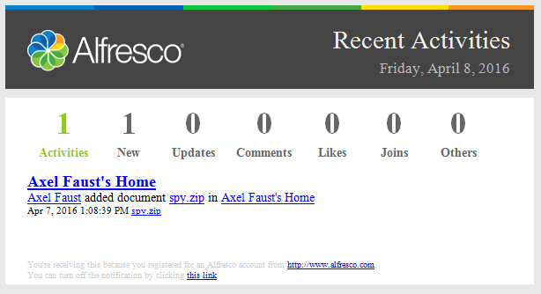
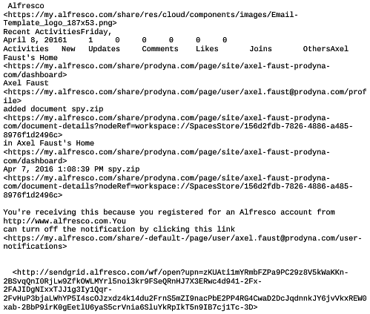
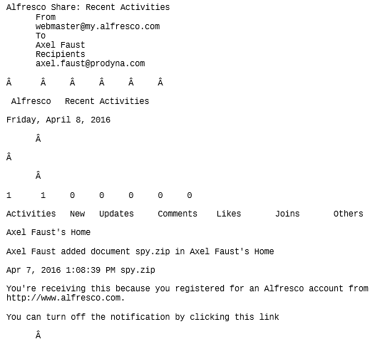
Email Rendering / Previewing
Outlook
EML in Share
MSG in Share

Slide 16
Email Rendering / Previewing
Addons
Contentreich „Human readable emails“ (EML, free)
Alfresco Outlook Integration
ecm4u „Email for Share“ (EML/MSG)
No reason not to be in core
POI included (HTML extraction from MSG)
(Open|Libre)Office for HTML => PDF
Open Source wkhtmltopdf

Slide 17
Export/Import
Content
Metadata
Users
Workflows
Permissions
…

Slide 18
Export/Import
Importing and exporting ACP files from Share UI: https://github.com/atolcd/alfresco-share-import-export
Importing and exporting site-based content and user information: https://github.com/wabson/share-import-export
Still no solutions for workflows and custom objects.

Slide 19
User Substitution
Most countries: 15-25d paid, 5-30d sick leave
What happens to your content / processes?
Requirements for substitute
Same content permissions
Same task / workflow access
Identical views

Slide 20

User Substitution
Simplistic approach
„Full Substitute“
Activateable
Cookie / AttributeService
Use of runAs feature
„Minor“ effort req.
Alternatives
Complex custom addon
Req. sub-set (ITD OrgChart)
Web Scripts API
Repo
Custom Authenticator
Custom Filter
Web Script X
Servlet

Slide 21
Document notifications with flexible configuration
Default behaviour:
Notify users about all updates on the site
Expected behaviour:
Let users subscribe to content and events (and unsubscribe then!)

Slide 22
Document notifications with flexible configuration
Allow users to unsubscribe: http://www.seedim.com.au/content/alfresco-email-notifications
Notify users about changes in documents they updated earlier or they mentioned in assocs of: https://github.com/ITDSystems/alfresco-inform-policy-extension-repo
#TODO Allow users to configure their subscription in UI.

Slide 23

Top 10 missing features (and ways to add them)
Oksana Kurysheva / Axel Faust

Slide 24
Top 10 missing features (and ways to add them)
Oksana Kurysheva / Axel Faust

